Slide 1
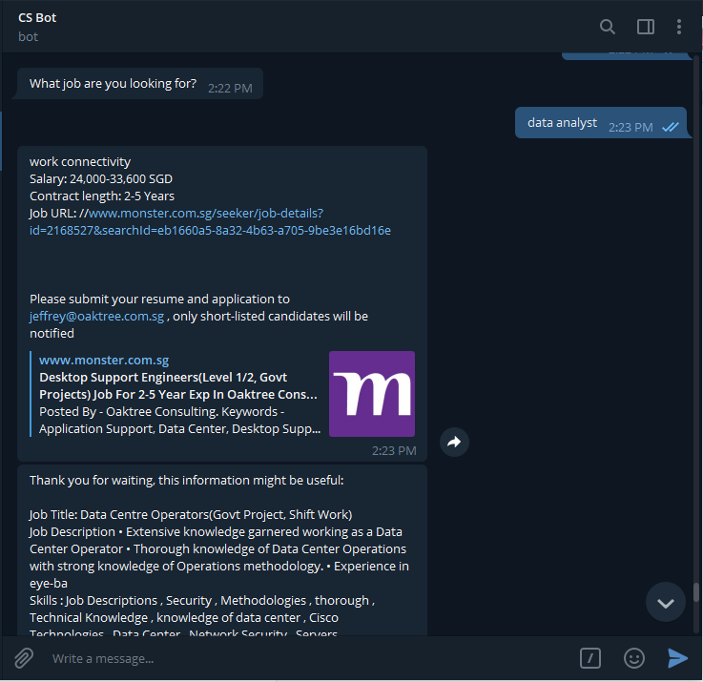
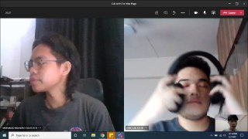
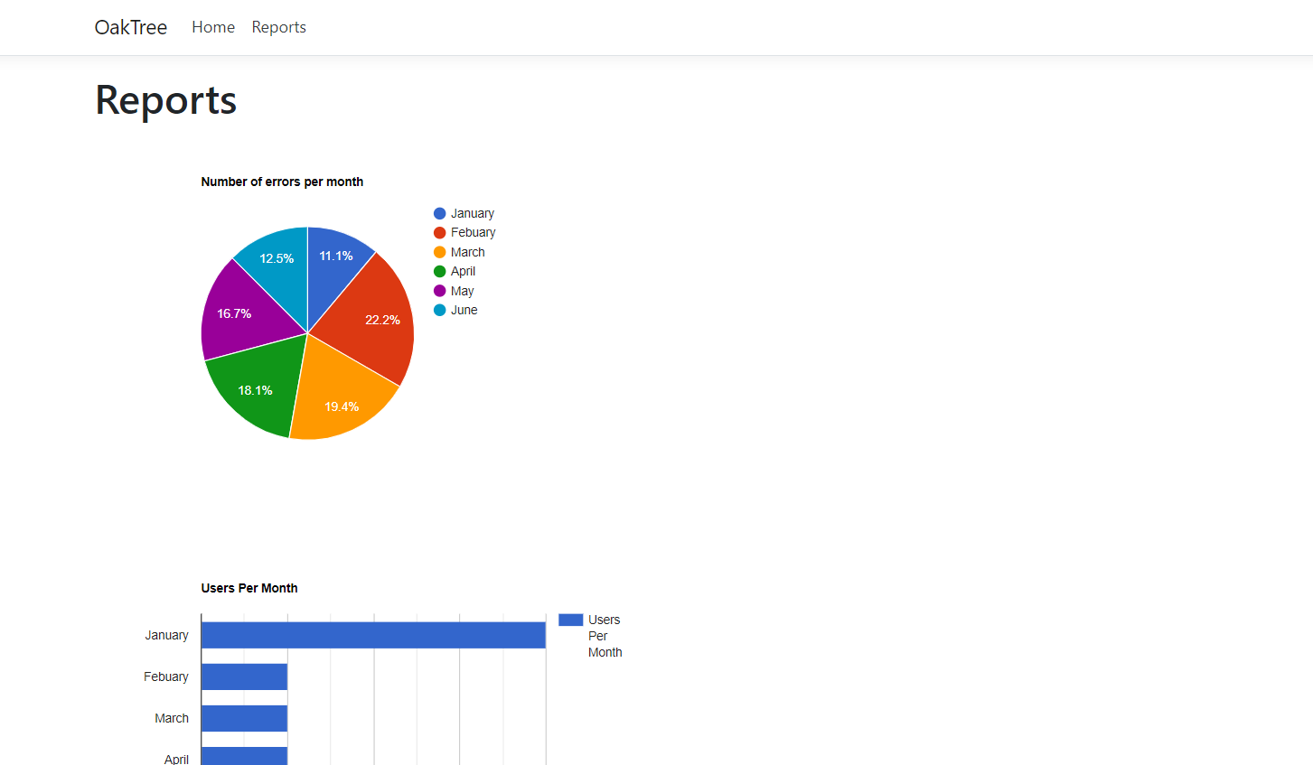
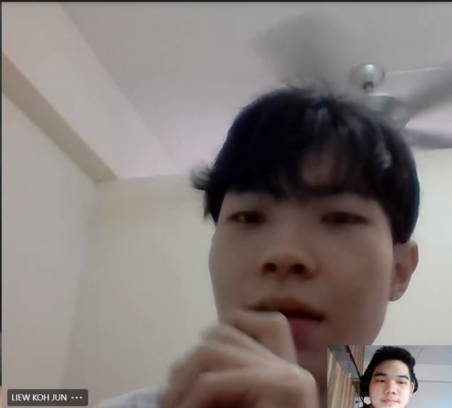
Customer Service Bot for a HR Recruitment Agency Partner Organisation: Oaktree Consulting
Project Overview
Problem: Time, effort and money is wasted to have Human Resources agent(s) to be on desk 24/7, providing live support. Especially when answering repetitive enquiries from Jobseekers.
Requirements: To learn and pick up IBM Watson Assistant Enterprise AI skills and relevant Technologies such as Node.js to design and develop a Chatbot
Solution: To create a chatbot to allow users to find specific job applications in an all-in-one channel
Technologies: IBM Cloud, IBM Watson Assistant,IBM Watson Discovery, Knowledge studio, IBM DB2, Node Red, HTML, Visual Studio, UI Path, Python
Dialog between user and CS Bot
Data collected from texts in the form of charts
Team Members:
Mohamad Iskandar Syah B M H (Team Coordinator) ,
Greg Lau Kai Jie,
Liew Koh Jun
Mr Ho Chee Wai (Supervisor)
Notes:
NOTES
Refer to write ups in ‘Past Projects for Reference’ Booklet for Project overview write ups - http://yoda.soi.rp.edu.sg/wiki/index.php/FYP_Wiki
ENGLISH - British E.g. organisation VS organization
Font: RP approved font - Arial family only.
Header: Arial Bold
Copy text: Arial regular or Arial Bold. Use Emphasis of our SOI orange in moderation.
Picture frame – Give a 4.5 or 6pt orange outline.

